Slide 1
A PROJECT
ON IMPLENTATION OF DATA STORY TELLING USING GRAPHICS AND ANIMATION APPS

Slide 2
PRESENTED BY:
OMEIRI FAVOUR

Slide 3
WHAT IS DATA VISUALIZATION?
Data visualization is the graphical representation of information and data. By using visual elements like charts, graphs, and maps, data visualization tools provide an accessible way to see and understand trends, outliers, and patterns in data. Additionally, it provides an excellent way for employees or business owners to present data to non-technical audiences without confusion.

Slide 4
Advantages of Data visualization
Our eyes are drawn to colors and patterns. We can quickly identify red from blue, and squares from circles. Our culture is visual, including everything from art and advertisements to TV and movies. Data visualization is another form of visual art that grabs our interest and keeps our eyes on the message. When we see a chart, we quickly see trends and outliers. If we can see something, we internalize it quickly. It’s storytelling with a purpose. If you’ve ever stared at a massive spreadsheet of data and couldn’t see a trend, you know how much more effective a visualization can be.
Some other advantages of data visualization include:
Easily sharing information.
Interactively explore opportunities.
Visualize patterns and relationships.

Slide 5
WHAT IS DATA STORYTELLING?
Data storytelling is the method of translating data analyses into an understandable and engaging story that makes it memorable for the audience. Common types of data storytelling include infographics, data visualizations, and scientific illustrations.
Creating good data stories is important because complex data and analytics can be difficult for people to understand. By using data storytelling techniques, you can help a wider audience understand the main points of complicated information and it can be a powerful tool to influence people's decisions.
.

Slide 6
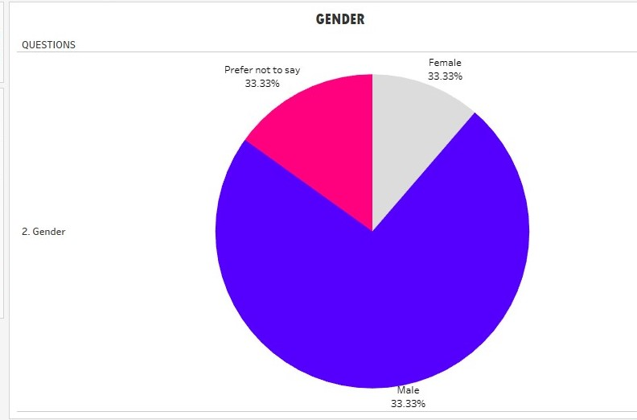
DATA STORYTELLING EXAMPLE
The image below shows a data storytelling example that uses pie charts and color design to highlight the gender that are interested in learning data storytelling using Tablueau .

Slide 7
Tools and Methodoly
Excel
Tableau
SPSS
  PROCESS:
  Data Cleaning: Removing Duplicates, handling missing values.
  Data Analysis: Identifying trends, segmenting responses
  Visualization: Creating dashboards and animations

Slide 8
KEY INSIGHTS
IT and Business departments have the highest course interest.
60% of students wants to learn data storytelling.

Slide 9
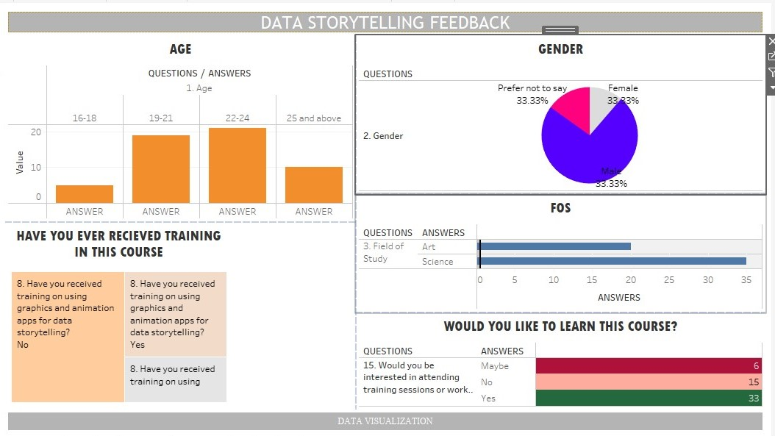
The table above tends to show students view on data storytelling from the analysis gotten from the survey carried out

Slide 10
IMPACT AND LESRNING
IMPACT:
Helped stakeholders understand coutrse preferences across departments
Improved decision making for course planning.
PERSONAL GROWTH:
Strengthened skills in data analysis , visualization, and storytelling.

Slide 11
THANKS FOR WATCHING!!!

